Slide 1








Estimating Rocket Launch Costs With Data
Theophilus Ankrah
15th June 2023

Slide 2





OUTLINE
Executive Summary
Introduction
Methodology
Results
Visualization – Charts
Dashboard
Discussion
Conclusion
YOUR-X LOOKS VERY NICE!
MY WHAT?
?

Slide 3
EXECUTIVE SUMMARY
Summary of methodologies
Data Collection through API
Data Collection with Web Scraping
Data Wrangling
Exploratory Data Analysis with SQL
Exploratory Data Analysis with Data Visualization
Interactive Visual Analytics with Folium
Machine Learning Prediction
Summary of all results
Exploratory Data Analysis result
Interactive analytics in screenshots
Predictive Analytics result

Slide 4
INTRODUCTION
Project background and context
Space X advertises Falcon 9 rocket launches on its website with a cost of 62 million dollars; other providers cost upward of 165 million dollars each, much of the savings is because Space X can reuse the first stage. Therefore, if we can determine if the first stage will land, we can determine the cost of a launch. This information can be used if an alternate company wants to bid against space X for a rocket launch. This goal of the project is to create a machine learning pipeline to predict if the first stage will land successfully.
Problems you want to find answers
What factors determine if the rocket will land successfully?
The interaction amongst various features that determine the success rate of a successful landing.
What operating conditions needs to be in place to ensure a successful landing program.

Slide 5


Slide 6
METHODOLOGY
Data collection methodology:
Data was collected using SpaceX API and web scraping from Wikipedia.
Perform data wrangling
One-hot encoding was applied to categorical features
Perform exploratory data analysis (EDA) using visualization and SQL
Perform interactive visual analytics using Folium and Plotly Dash
Perform predictive analysis using classification models
Classification models were defined and tuned to obtain the best parameters

Slide 7
Data Collection
The data was collected using various methods
SpaceX API was selected as the primary data source – Achieved using get requests.
Data was collected converted in a pandas dataframe. – Achieved by normalizing json formatting
Collected data was cleaned, checked for missing values and replaced them. - Using pandas
Falcon 9 launch records were extracted from Wikipaedia. – Achieved through web scrapping
The collected data was converted into a tabular dataframe for further analysis. – Using pandas

Slide 8
Data Wrangling
Exploratory data analysis was initiated to determine training labels for our models.
Calculated columns for the totals for all Falcon 9 launch sites and target orbits were found and included for further analysis.
Landing outcomes were categorized based on retrieved data and placed in a target column for our model.

Slide 9
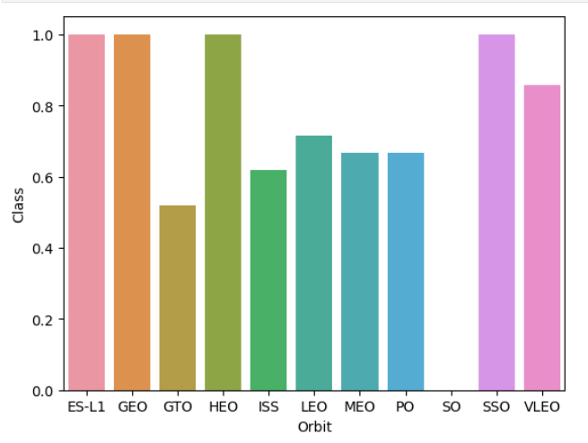
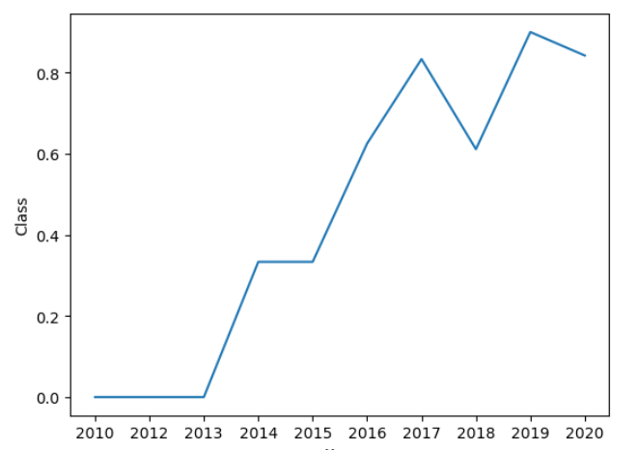
EXPLORATORY DATA ANALYSIS VIA DATA VISUALIZATION
Using data visualizing the following relationships were discovered between:
flight numbers and launch sites
payloads and launch site,
success rate of each orbit type,
flight number and orbit type,
Key take aways :
An upward trend was observed for yearly launch success trend.
Target orbits had varying success rates.
Plot of success rate of each target orbit
Trend of yearly success rate

Slide 10
EXPLORATORY DATA ANALYSIS VIA SQL
Further exploratory analysis was carried out using SQL via an IBM DB2 connection
Key insights:
Average payload for Falcon 9 v1.1 = 2,928.4 kg
Total Successful missions for Falcon 9 = 100
Total Failed missions for Falcon 9 = 1

Slide 11
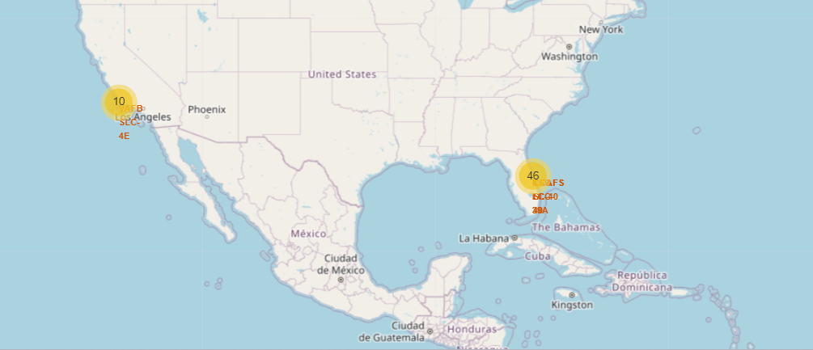
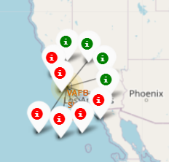
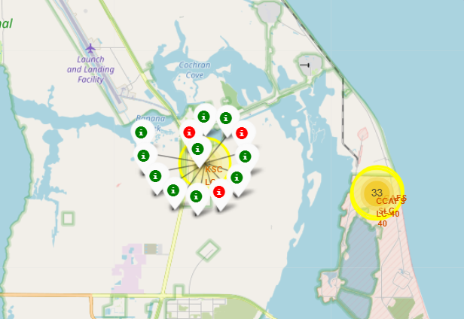
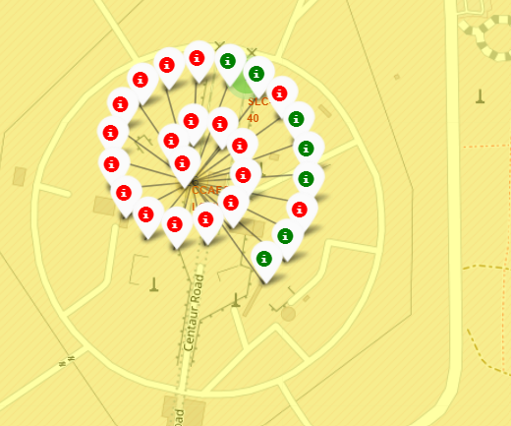
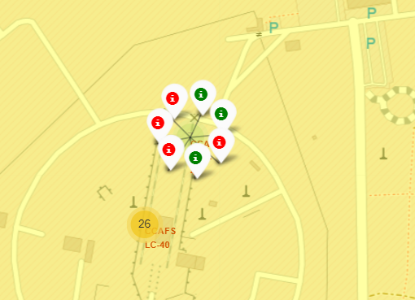
Building Interactive Maps with Folium
All launch sites were marked on the map – Observation made for all launch site being close to the beach and sea.
Successful launches were marked with green markers with a class assignment of 1 and 0 & red markers for unsuccessful launches. – KSC LC – 39A had the highest success rate
Site success rates were emphasized through marker clusters that clearly tell the general success rate for each site.
Nearness to key landmarks was also investigated for possible relevance.
Success rates by Launch Sites via marker clusters
Launch sites observed to be near beaches or close to the open sea
VAFB SLC-4E
KSC LC-39A
CCAFS SLC-40
CCAFS LC-40

Slide 12
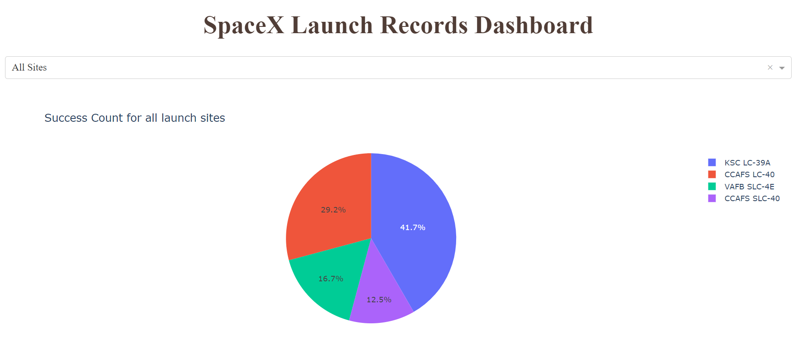
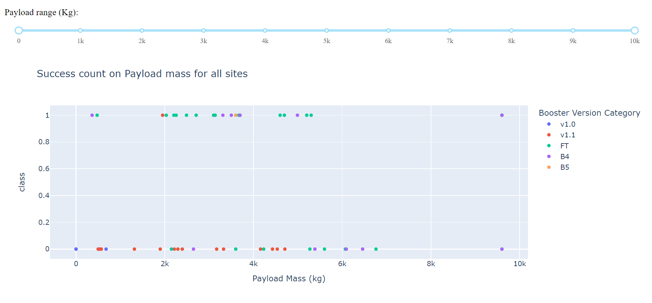
PLOTLY DASHBOARD
An interactive dashboard was developed with the following properties:
1. A pie chart to communicate successful launches by certain sites.
2. A scatter plot to show the relationship between Mission Outcome and Payload Mass for the different booster versions

Slide 13
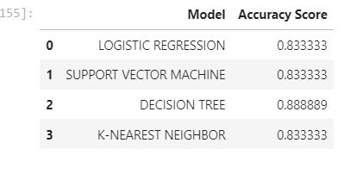
Predictive Analysis
The objective of this analysis was to produce a predictive model that can predict with a high accuracy whether a launch will be successful or not.
The collected data is transformed and normalized before being split into training and testing data – 80% used for training and 20% for testing.
Several models were developed, and their parameters tuned to obtain the highest performing model parameters.
The prediction accuracy of all the models was compared and found as:
Key insights:
Almost all models had similar accuracy scores
In this case, Decision tree fared best after multiple runs
However, Decision tree accuracy changes at every run and is sometimes the lowest
All models turned out high accuracies

Slide 14
DISCUSSION
Was enough data collected for the project?
Was data credible and unbiased?
Did the methodology lack in any way?
Were the dependent variables enough to inform the model?
Were the right models selected?
Did the tuning improve model delivery?
Can the model be improved?
Was the objective of this project achieved?
MY WHAT?
STILL STICKING WITH YOUR-X?
💡

Slide 15

CONCLUSION
We can conclude that:
SPACEX gets better success rates with increasing number of launches
KSC LC-39A had the most successful launches of any sites.
Orbits ES-L1, GEO, HEO, SSO, VLEO had the most success rate.
Launch success rate started to increase in 2013 till 2020.
The Decision tree classifier is not the best machine learning algorithm for this task as with each run , the accuracies keep changing.
Logistic regression model is recommended as we can also check for the probability of a prediction and has equally high accuracy as the others.

